Slide 1

Midwest Guardrail System Without Blockouts
J.D. Reid, R.K. Faller,
R.W. Bielenberg, and K.A. Lechtenberg
Midwest Roadside Safety Facility
University of Nebraska-Lincoln
TRB 2013
January 14, 2013

Slide 2
Acknowledgments
Midwest States Pooled Fund Roadside Safety Program
MwRSF Staff

Slide 3
Introduction
Full-scale Crash Testing
Comparison: blocked vs non-blocked
Rail-Post Attachment
Blockout Importance
Conclusions

Slide 4
Proprietary Non-Blocked Systems
T-31 Guardrail (Trinity Highway Products)
Gregory Mini Spacer Guardrail (Gregory Industries)
NU-GUARD-31 (Nucor Steel Marion, Inc.)

Slide 5
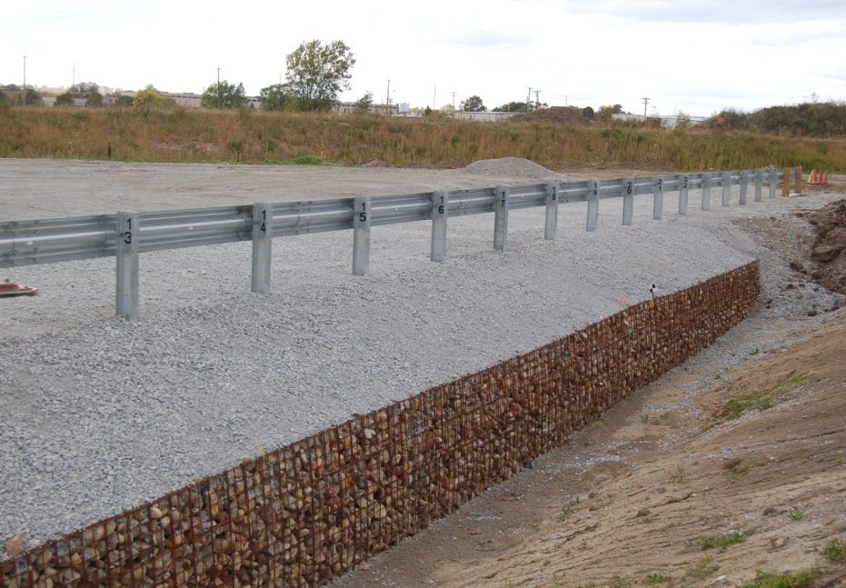
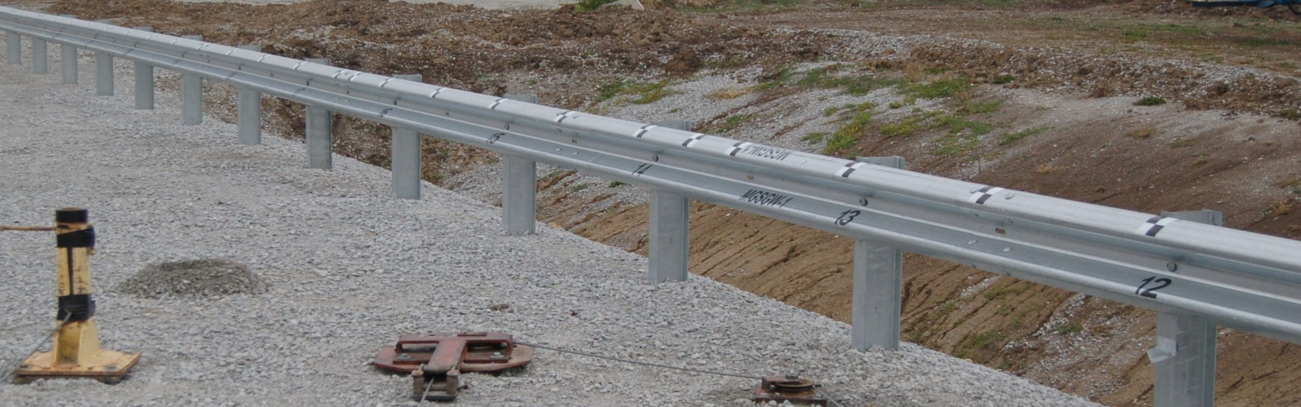
Non-Proprietary Non-Blocked Systems
Non-Blocked MGS for Wire-Faced Walls of Mechanically Stabilized Earth (TRB 2011)

Slide 6
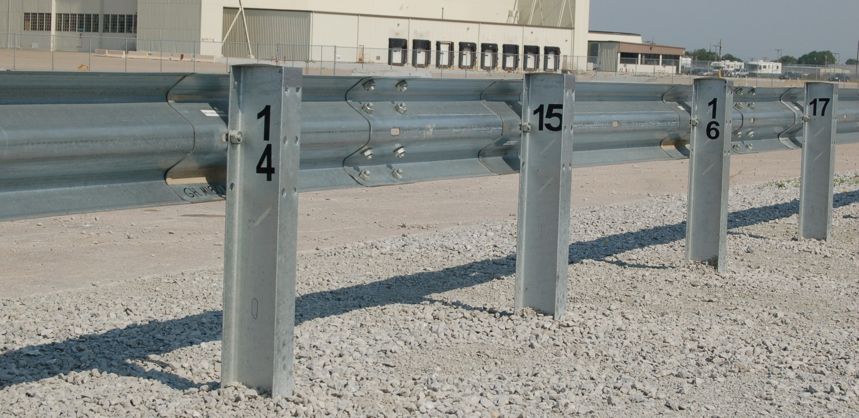
Design Details

Slide 7
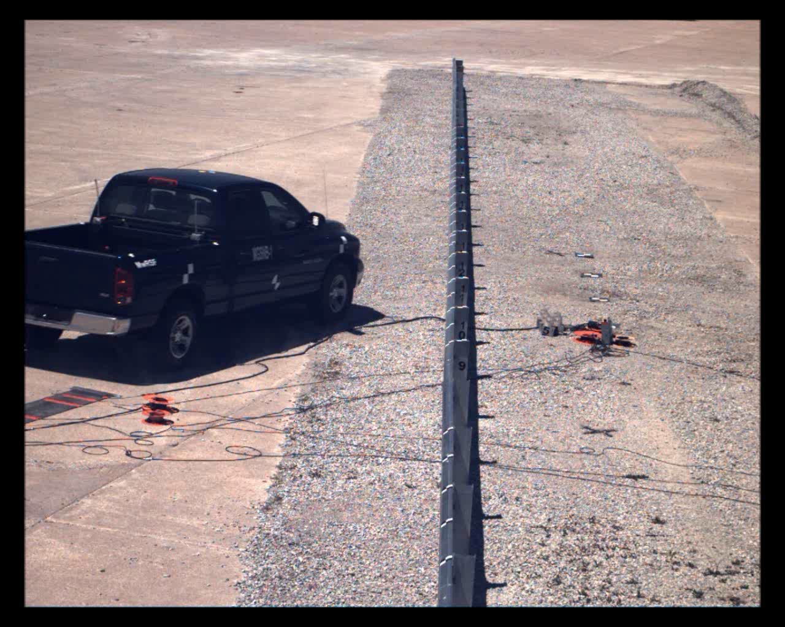
MGSNB-1: 62.7 mph @ 24.7 deg
OIV
17.1 ft/s
ORD
11.5 g

Slide 8
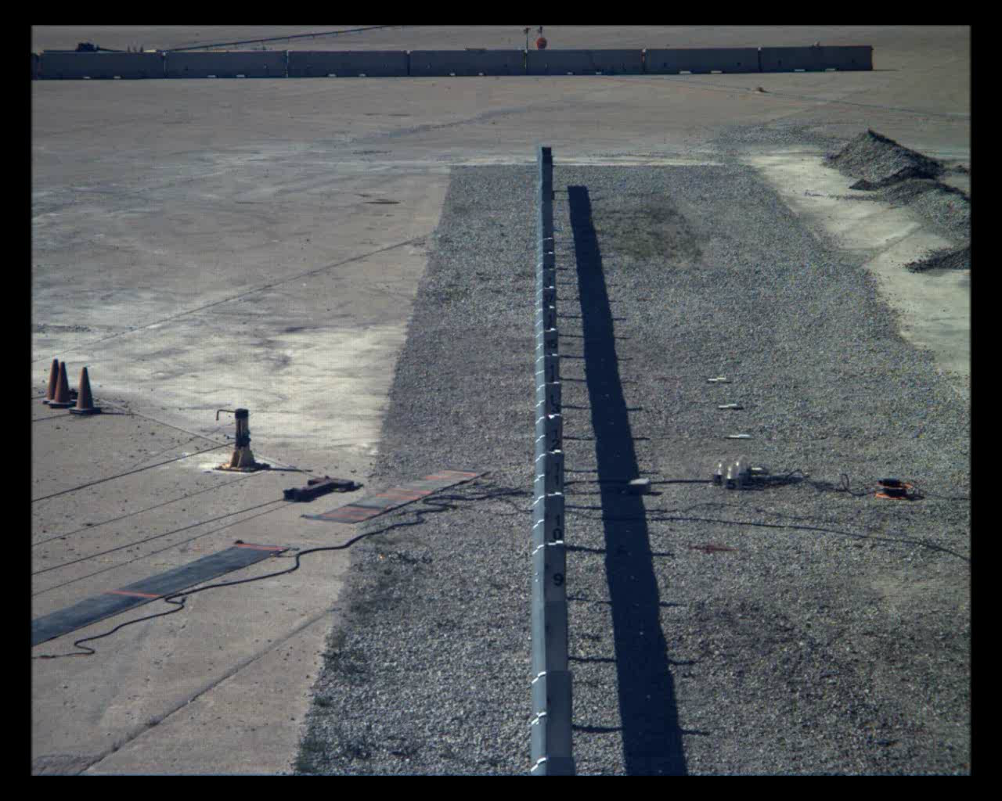
MGSNB-2: 63 mph @ 25.5 deg
OIV
31.3 ft/s
ORD
10.2 g

Slide 9
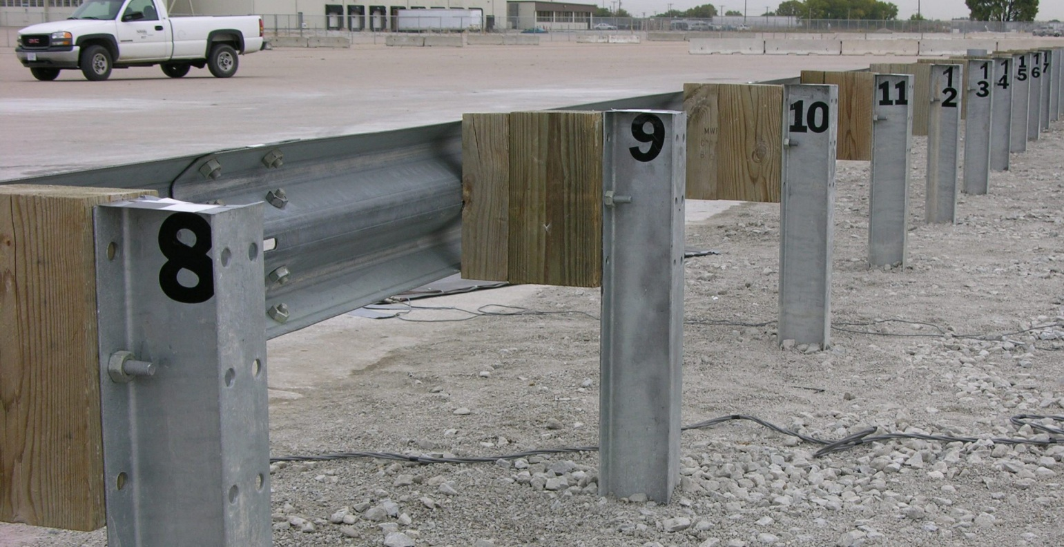

Blocked vs
Non-Blocked

Slide 10
Pickup Truck

Slide 11
Pickup Truck

Slide 12
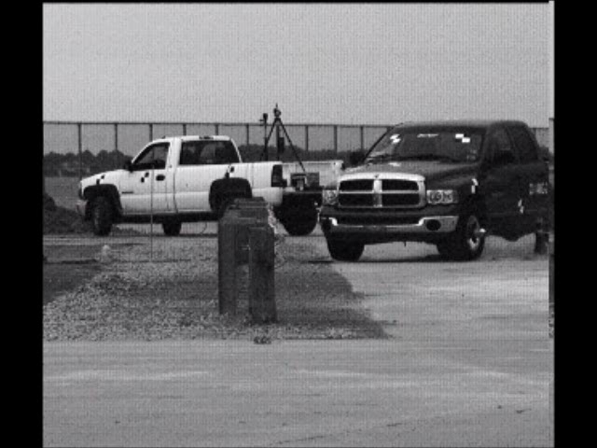
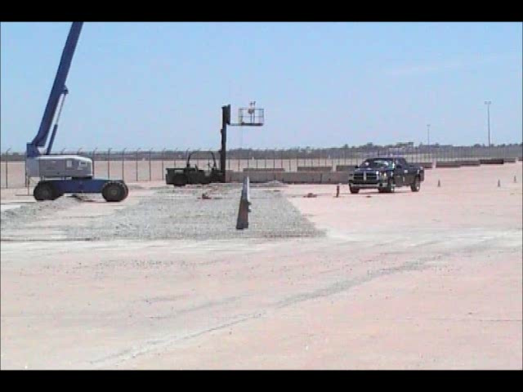
Pickup Truck
Blocked Non-Blocked

Slide 13
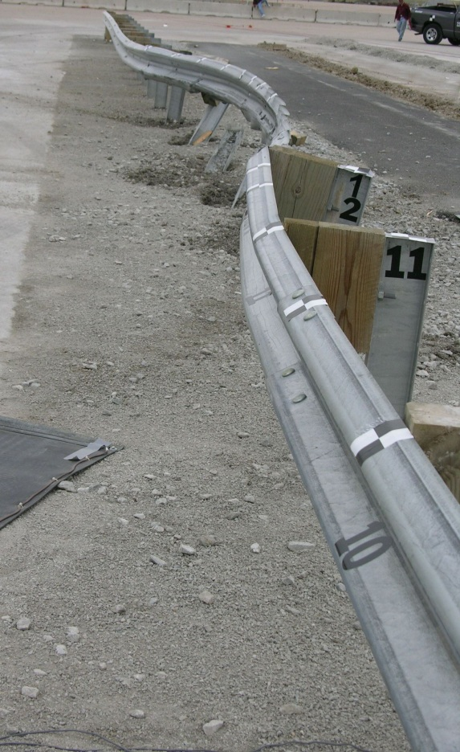
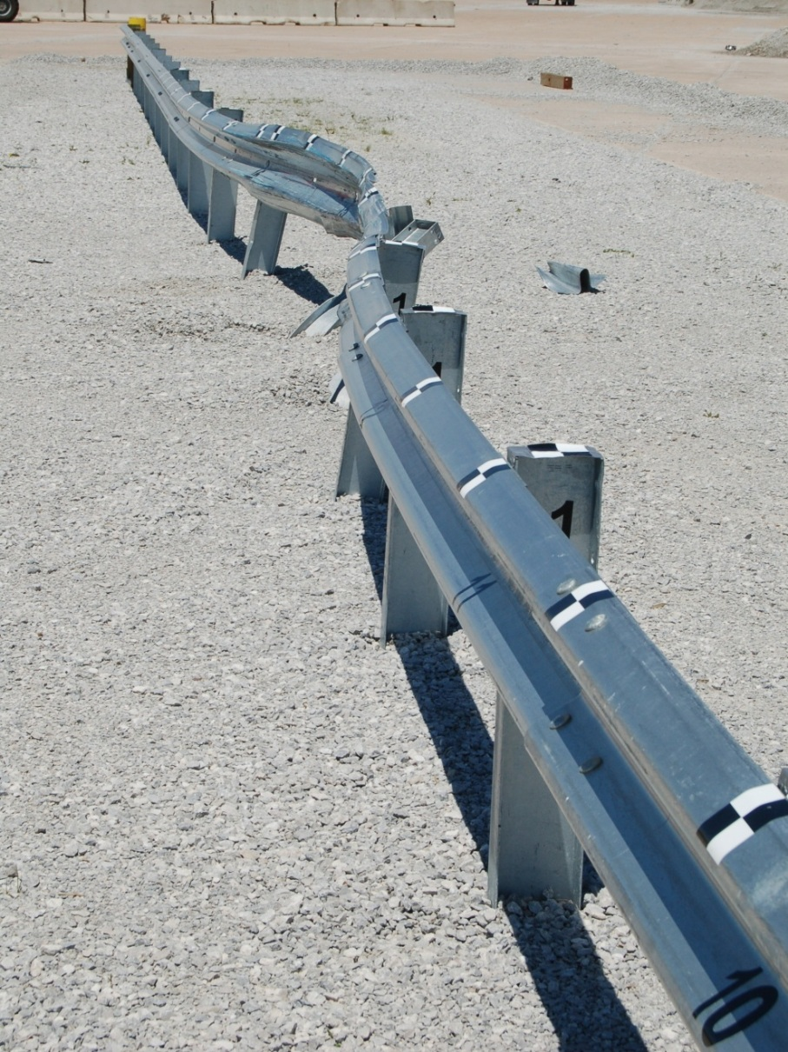
Pickup Truck

Slide 14
Small Car

Slide 15
Small Car

Slide 16
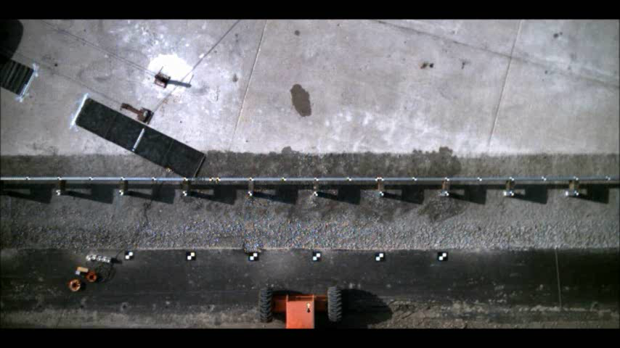
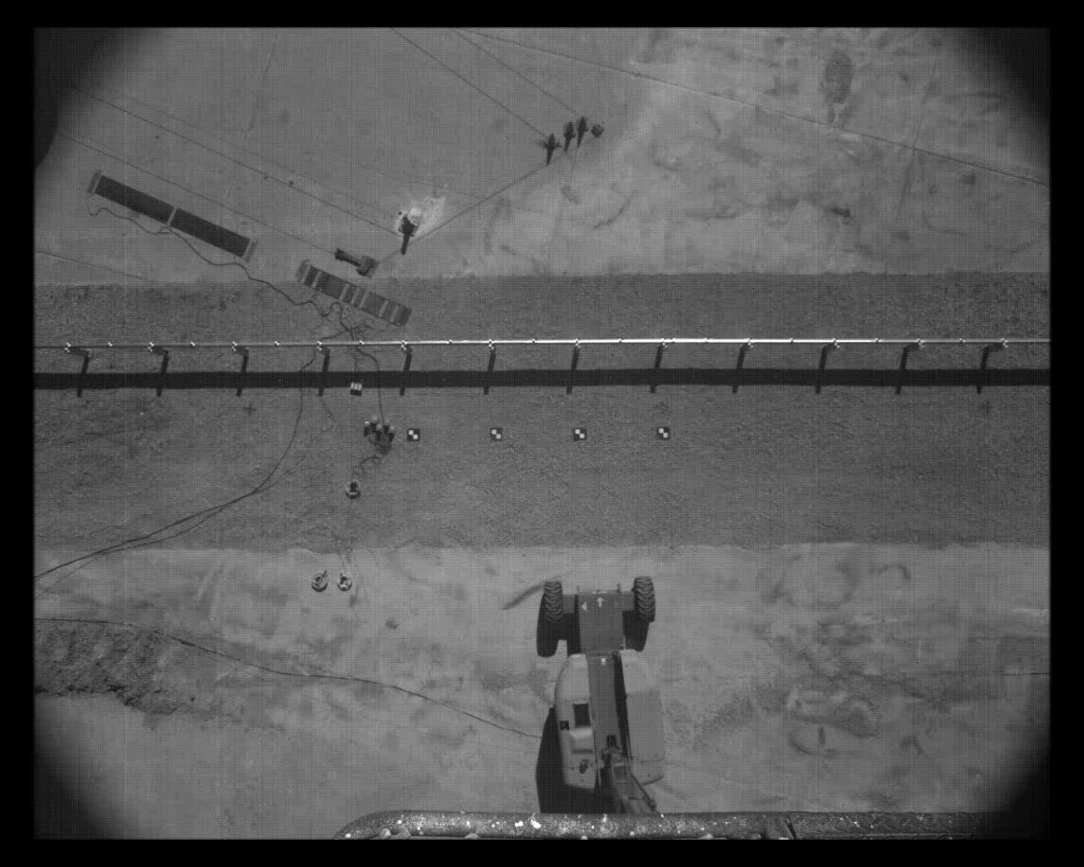
1100c – smoother with blocks
Blocked Non-Blocked

Slide 17
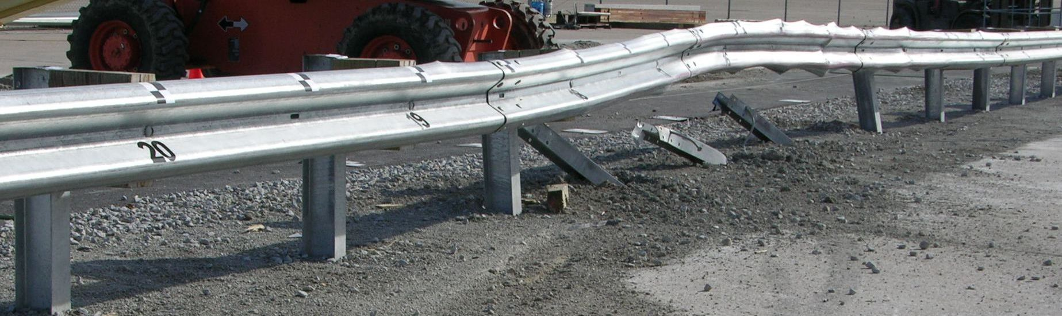
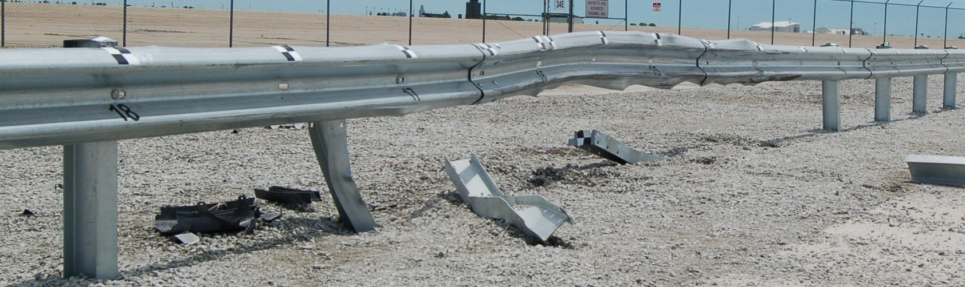
Small Car
Non-Blocked Blocked

Slide 18
Advantages of the Blocked MGS
Improved stability for both vehicles
Reduced snag
Reduced occupant risk measures

Slide 19
Outline
Full-scale Crash Testing
Comparison: blocked vs non-blocked
Rail-Post Attachment
Blockout Importance
Conclusions

Slide 20
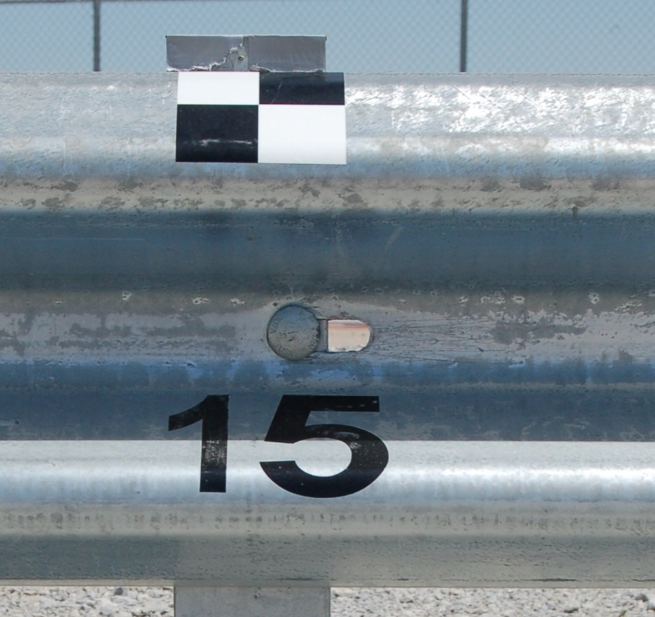
Rail-Post Attachment

Slide 21
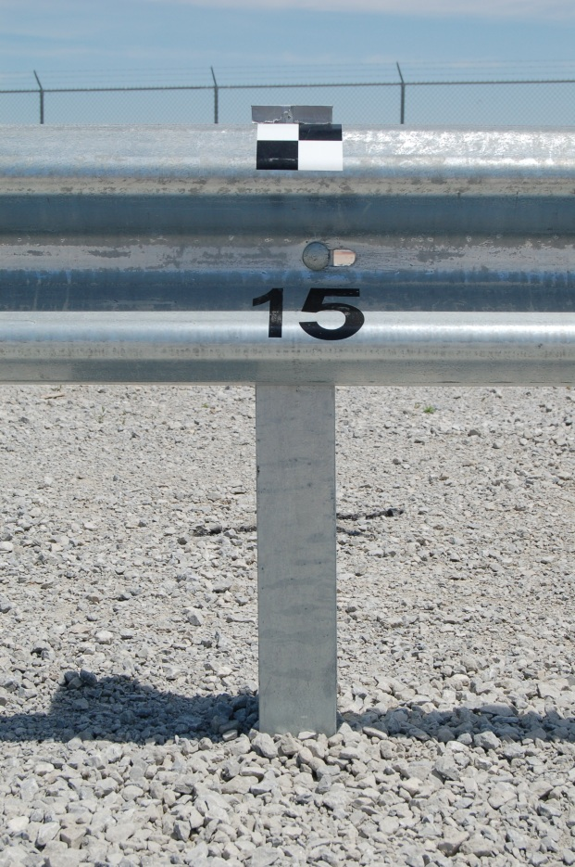
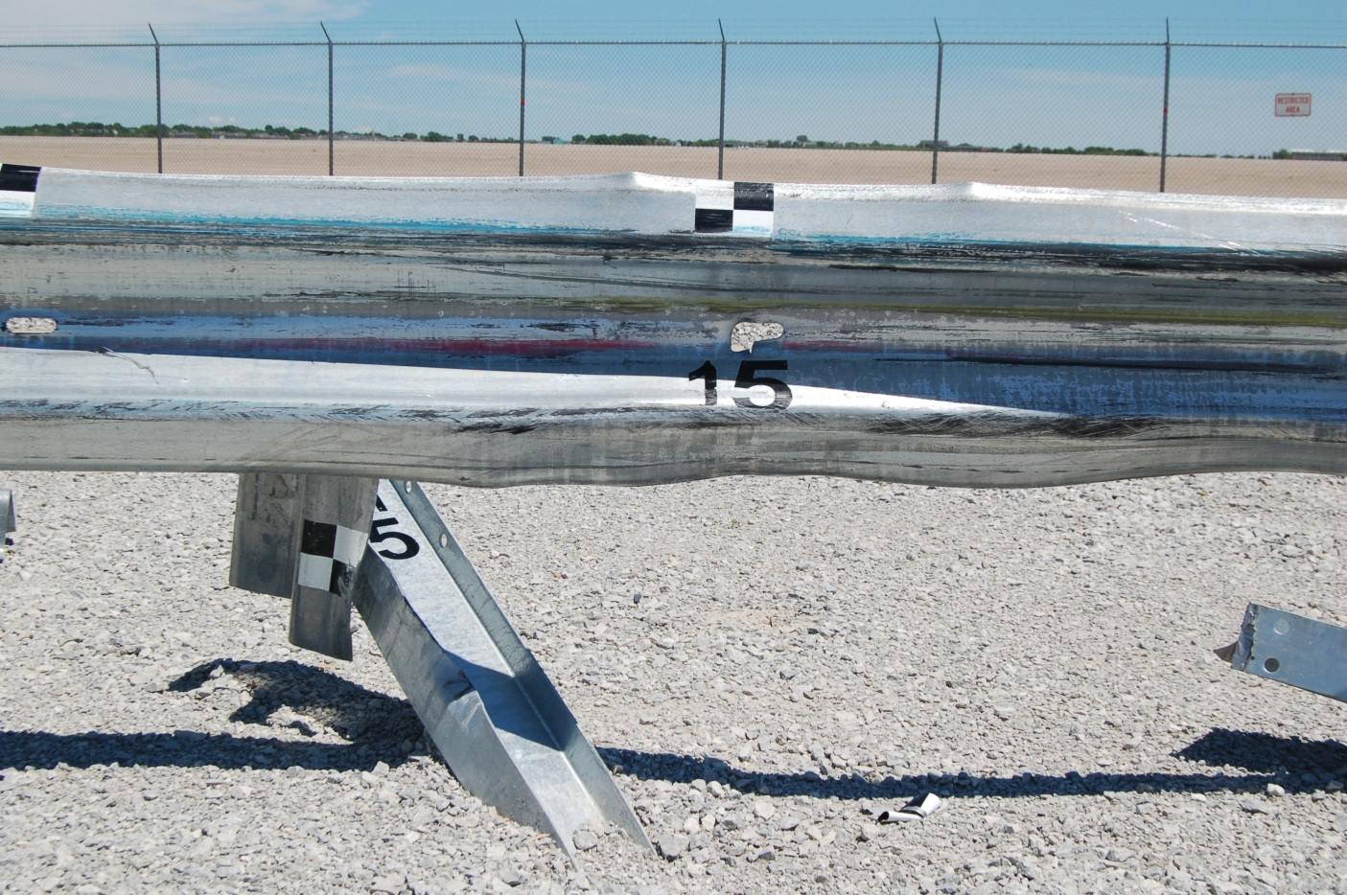
Rail-Post Attachment: 2270p

Slide 22
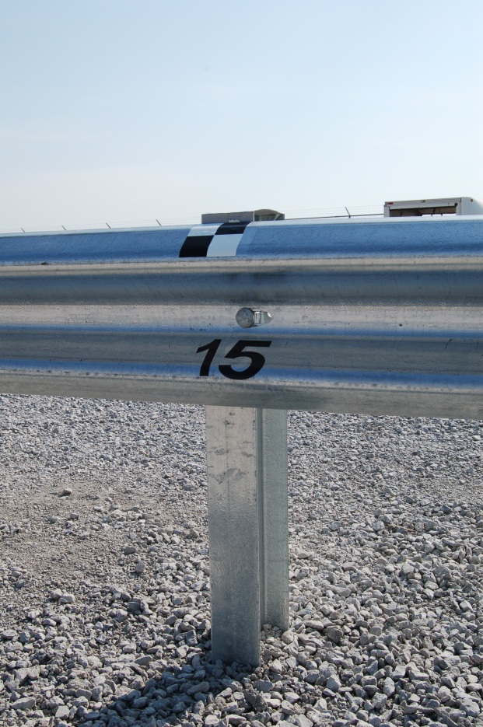
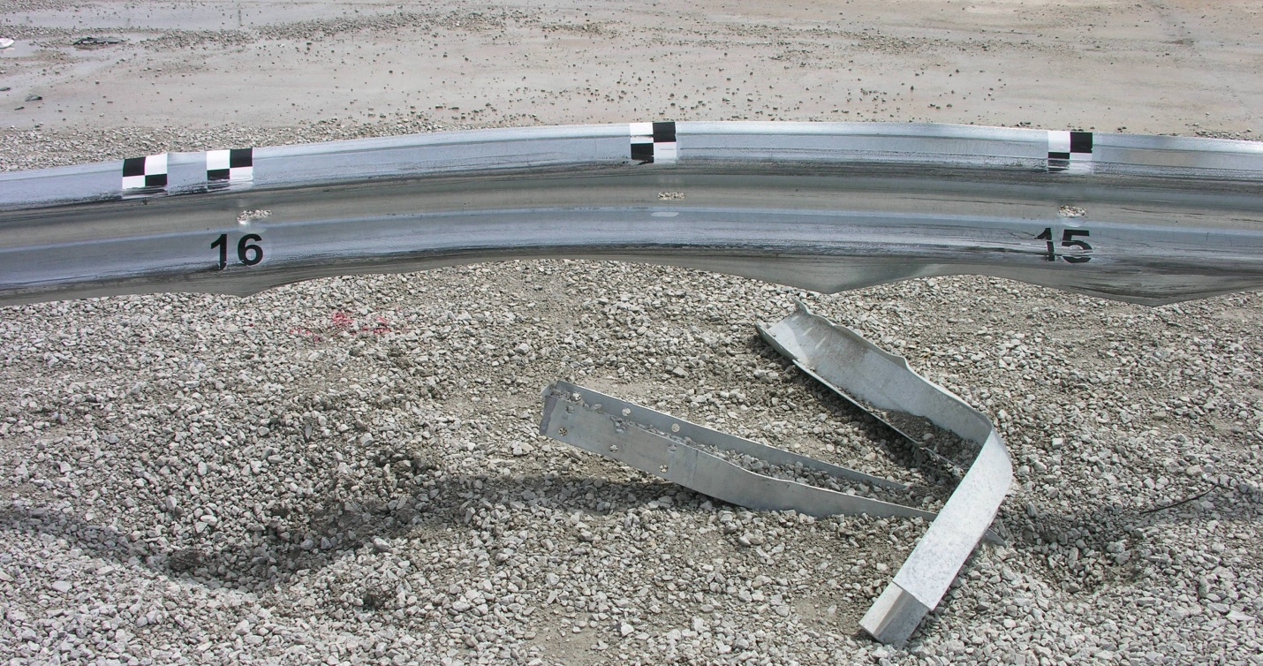
Rail-Post Attachment: 1100c

Slide 23
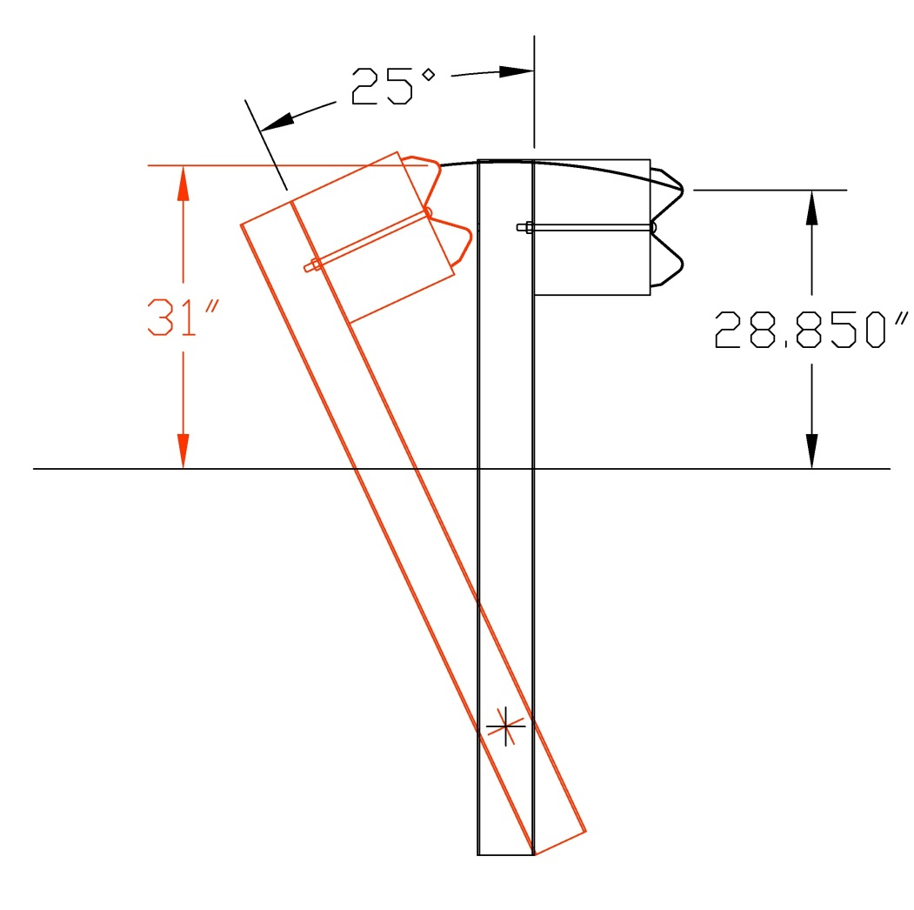
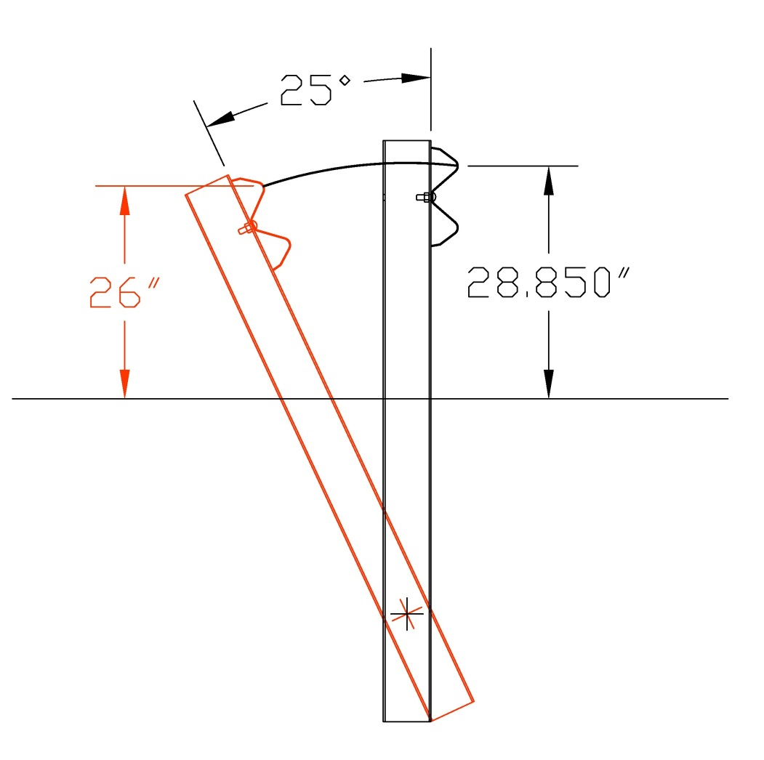
Blockout Importance

Slide 24
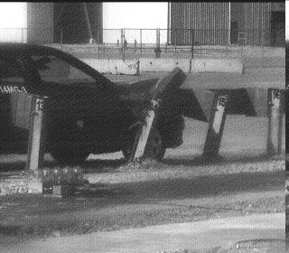
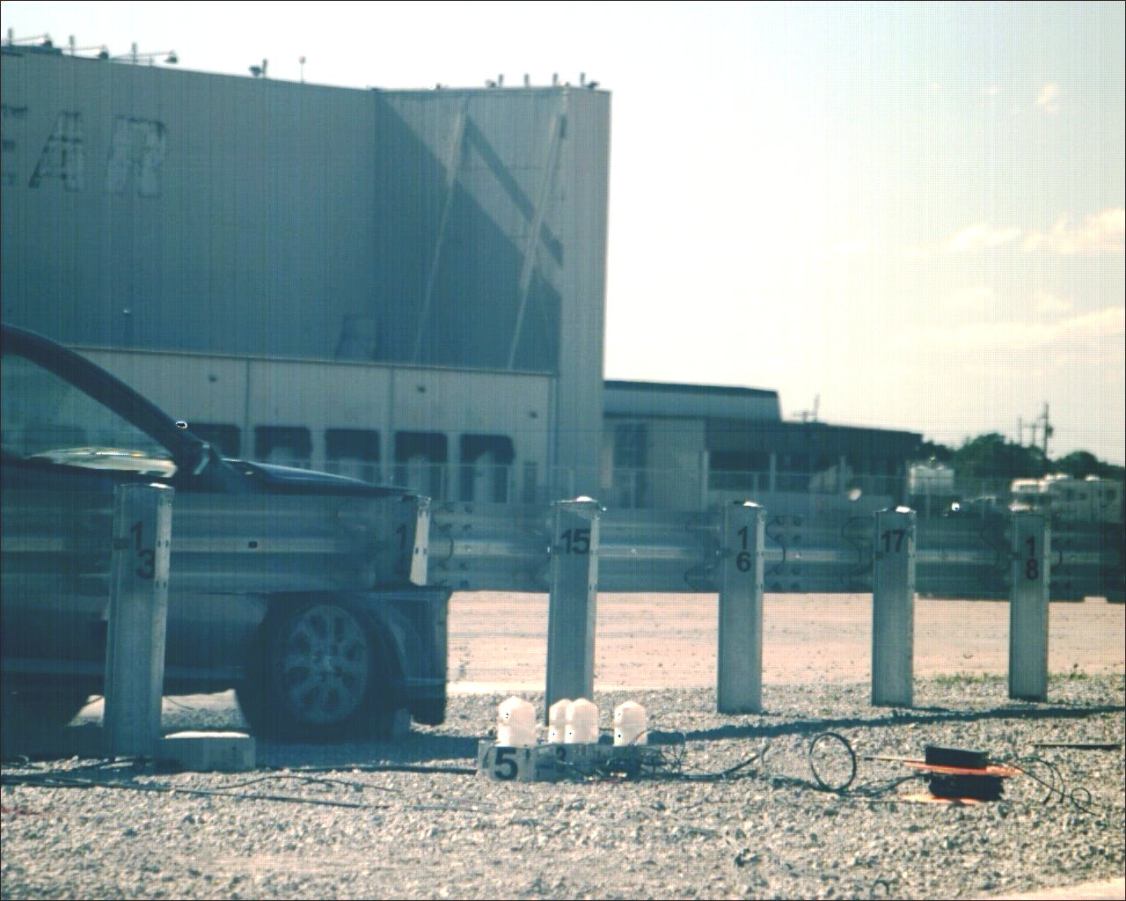
Blockout Importance
Blocked Non-Blocked
Post 14: No Wheel Snag Major Wheel Snag

Slide 25
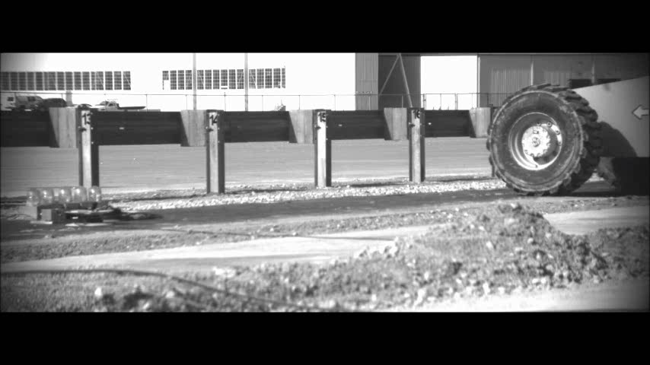
Blockout does not eliminate wheel snag

Slide 26
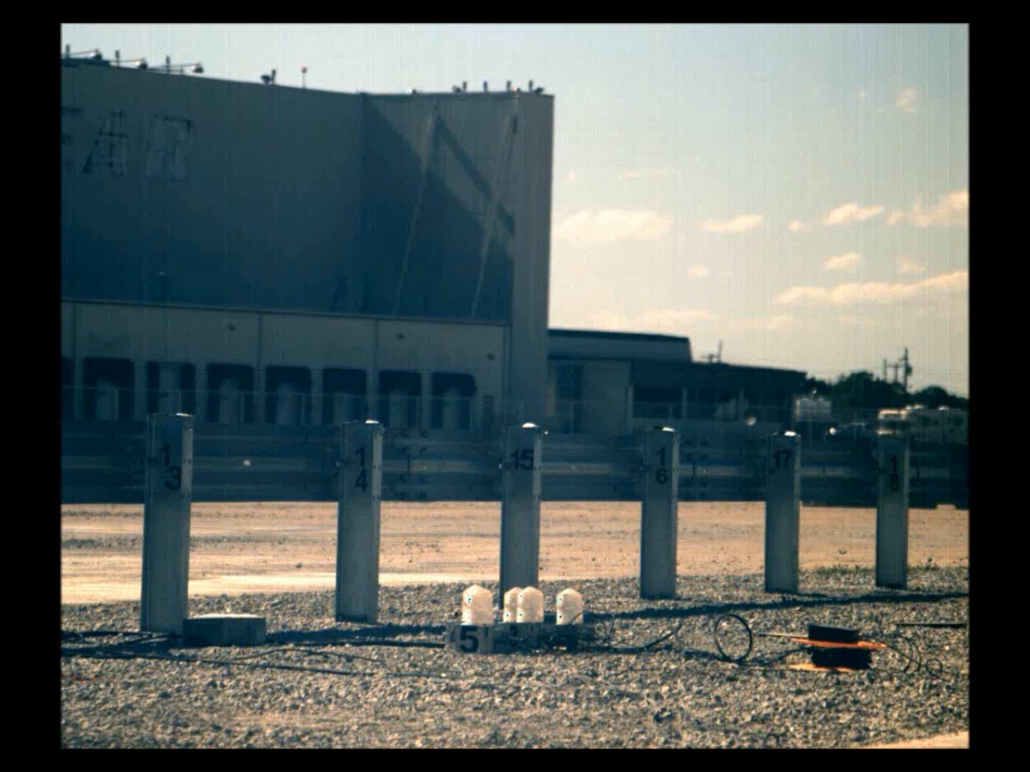

Slide 27
Conclusions and Recommendations
MGS without blockouts successfully crash tested
Rail effectively releases from post, even in worst case location
Blocked system performs better and is recommended if space is available
Special applications – see report

